Slide 1
Network Topology Exercise B V1.0
Overview
You have been given the routing tables of three routers: London, Paris, and Rome
Given the information provided in each of the router’s routing table you will be required to complete the following tasks:
Create a Network Topology Diagram, refer page 2
Answer questions, refer page 8, regarding the Topology Diagram and Routing Tables

Slide 2
Task 1 - Create a Network Topology Diagram
Refer to the Network Topology Diagram Layout, on page 3, which your diagram must conform with.
Refer to the Routing Tables, on pages 4 to 6, which contain the information needed to create your diagram.
Your can plan you diagram by creating a draft copy on page 7.
For assessment, your final diagram must be on page 8
On your final diagram show the following:
all interfaces, serial, fastethernet and loopback on each router
all serial point-to-point links between routers and links to LANs/VLANs
all network addresses with prefix

Slide 3
Task 1 - Network Topology Diagram Layout
Your answer must conform with the Drawing Symbols and Layout Below
Fa0/0
Serial Link
S0/0/1
LAN Link
Rx
Network Address/Prefix
Loopback0
(ip address/prefix)
Rx
Network Address/Prefix
S0/0/0
S0/0/1)
Serial Link
Network Address/Prefix
VLAN ID/Network Address/Prefix
VLAN Link
VLAN ID/Network Address/Prefix
Rx
S0/0/0)
VLAN ID/Network Address/Prefix
Fa0/1

Slide 4
Routing Tables
Paris (R1) Routing Table
Codes: C - connected, S - static, R - RIP, B - BGP
D - EIGRP, EX - EIGRP external, O - OSPF, IA - OSPF inter area
* - candidate default
Gateway of last resort is 55.0.8.42 to network 0.0.0.0
55.0.0.0/8 is variably subnetted, 5 subnets, 5 masks
C 55.0.8.40/30 is directly connected, Serial0/0/0
C 55.0.8.32/29 is directly connected, FastEthernet0/1.1
C 55.0.7.0/27 is directly connected, Loopback0
C 55.0.4.0/23 is directly connected, FastEthernet0/1.25
C 55.0.0.0/22 is directly connected, FastEthernet0/1.15
O*E2 0.0.0.0/0 [110/1] via 55.0.8.42, 00:24:35, Serial0/0/0

Slide 5
Routing Tables
London (R2) Routing Table
Codes: C - connected, S - static, R - RIP, M - mobile, B - BGP
D - EIGRP, EX - EIGRP external, O - OSPF, IA - OSPF inter area
* - candidate default
Gateway of last resort is 0.0.0.0 to network 0.0.0.0
201.5.5.0/30 is subnetted, 1 subnets
C 201.5.5.0 is directly connected, Serial0/0/1
55.0.0.0/8 is variably subnetted, 6 subnets, 6 masks
C 55.0.8.40/30 is directly connected, Serial0/0/0
O 55.0.8.32/29 [110/65] via 55.0.8.41, 00:25:58, Serial0/0/0
O 55.0.7.1/32 [110/65] via 55.0.8.41, 00:32:24, Serial0/0/0
O 55.0.4.0/23 [110/65] via 55.0.8.41, 00:25:58, Serial0/0/0
O 55.0.0.0/22 [110/65] via 55.0.8.41, 00:25:58, Serial0/0/0
C 55.0.8.0/27 is directly connected, Loopback0
S* 0.0.0.0/0 is directly connected, Serial0/0/1

Slide 6
Routing Tables
Rome (R3) Routing Table
Codes: C - connected, S - static, R - RIP, M - mobile, B - BGP
D - EIGRP, EX - EIGRP external, O - OSPF, IA - OSPF inter area
* - candidate default
Gateway of last resort is not set
201.5.5.0/30 is subnetted, 1 subnets
C 201.5.5.0 is directly connected, Serial0/0/1
S 55.0.0.0/8 [1/0] via 201.5.5.2
160.1.0.0/32 is subnetted, 1 subnets
C 160.1.1.1 is directly connected, Loopback0

Slide 7
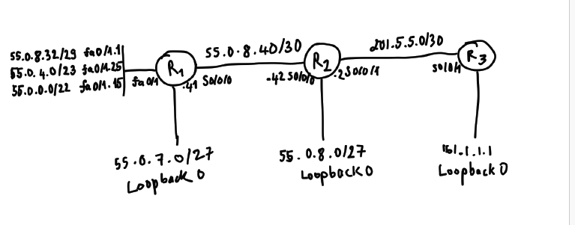
Task 1 - Network Topology Diagram

Slide 8
Task 2 – Questions regarding the Topology Diagram and Routing Tables
List the routers that use OSPF R1, R2
List the routers that use static routes R2, R3
List the routers that use only static routes R3
For each router determine how many static routes are mapped to exit interfaces
R2 has 1 static route map mapped to the exit interface
For each router determine how many static routes are mapped to next hop IP addresses
R3 has 1 static route map mapped to the next hop IP address
Which router is the gateway to Internet R2
List the routers that learn their gateway via OSPF R1
List the routers that use a static route to point to the gateway R3
For each Router list the networks learnt via OSPF
R1: 0.0.0.0/0
R2: 55.0.8.32/29, 55.0.7.1/32, 55.0.4.0/23, 55.0.0.0/22
On London what does[110/65] mean 110 is AD and 65 is cost (metric bandwidth)
On London what does 00:25:58 mean time since the last update
Which router is the ISP R3
List the routers that have LANs, and how many LANs are there R1, 3 Lans
What are the IP addresses of the interfaces on the London router s0/0/0-55.0.8.42, lo0-55.0.8.1, s0/0/1-201.5.5.2

